Slide 1
Ml Hackathon Project on Child-Birth and Child Dataset Provided By Yenapova Medical College
Submitted To:-Board Infinity
Submitted By:- Rishav

Slide 2
Introduction:-
Here ,YENAPONA MEDICAL COLLEGE provided us the two Data Set
Of Name Child-Birth and Birth Dataset .These datasets are all about Babies Birth and Their Required Analysis Report.All where we have to do some Statistical Analysis and Find some Insights and also Build a Regressor Model.
In Birth Dataset I have Different Feauteres and This Dataset Contain Many Null Values.First of all I do a Exploratory Data Analysis on Whole dataset To clean Null Values,Remove Outliers and Also Lot of Statsctical Analysis by the Use of Charts to Find the Insights From Them.
In Birth Dataset I Did same Things But This Dataset Does Not Had any null Values.Here I just Detect Outliers And Removes Them and after that I did some Statistical Analysis by The Use of Various Charts.After that I just Buid Linear regression and Random Forest Regressor Model to Predict The Birth_weight.

Slide 3
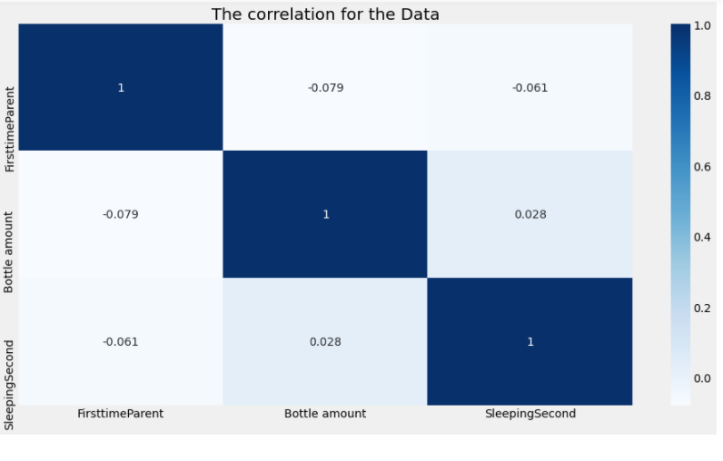
INSIGHT:-1 . by using heat map to find the correlation we can see that,those who become first time parent are negatively corelated with bottle amount and sleeping second.
we can also visualize that bottle amount in dataset is positively corelated with the sleeping second that mean if the baby feeding have been done than the babies will sleep more as compared to less feeding

Slide 4
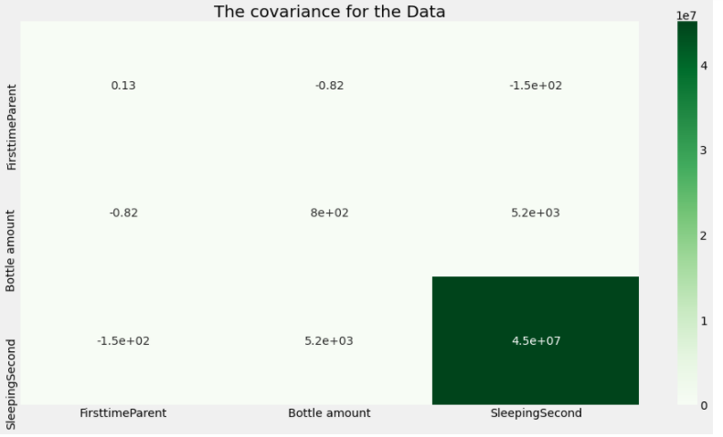
Insight:- from this heat map we can analyed the data and make a decision that the covariance between first time parent and sleeping second of babies are vary high. so that we can say that both the data move together in the dataset

Slide 5
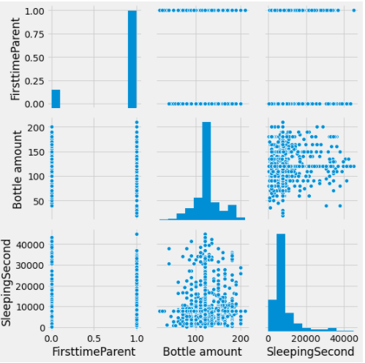
INSIGHT:-From the above pairplot we can see that Bottle Amount does not follow a Linear relationship with Sleeping Seconds.which means if the Sleeping seconds are High than Bottle Amount will be Low.If the Child will Sleep More than he/she will Feed Less.

Slide 6
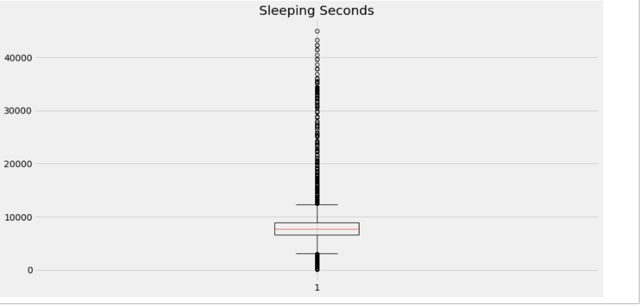
INSIGHT:-From the Above Boxplot we can clearly see so much Outliers.which means most of Babies Sleeps More which is not so good for Baby Health.Doctors have to Focus on that

Slide 7
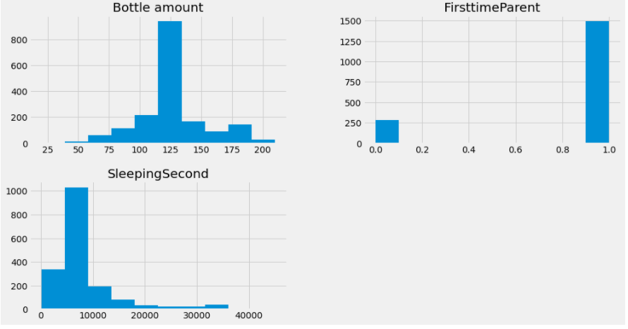
insight:- from histograms we made gave as the knowledge that the bottle amount is equally distributed throughout the graph i.e makes and gaussian distribution
insight:- In the third histogram for sleeping second we can see that the graph is negatively skewed in the dataset that mean the sleeping time of babies are no equally distrubuted,some of them have a good sleep as compared to others

Slide 8
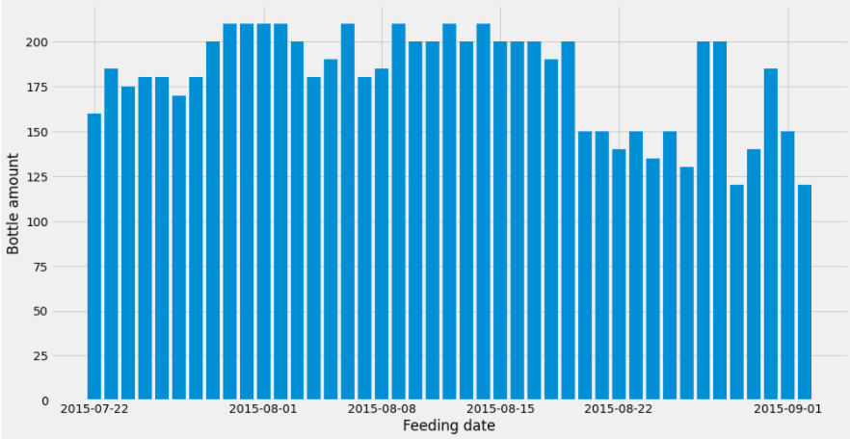
Insight:- The above Bar graph shows that the Bottle Amount is High b/w 2015/08/01 to 2015/08/08.Which describes that Crying time and Sleeping time of Babies will be Less b/w These days as Compare to Other Days.

Slide 9
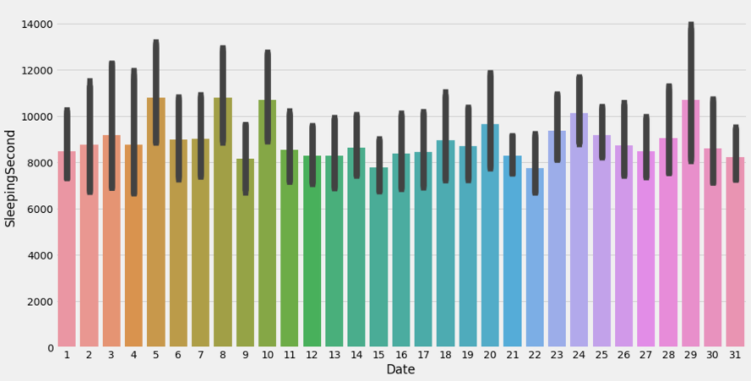
Insight:- The above Bar graph shows that the Sleeping Second is very High on Date 2015/08/29.Which describes that Crying time and Feeding Time of Babies will be Less on Other Days as Compare to this Day.

Slide 10
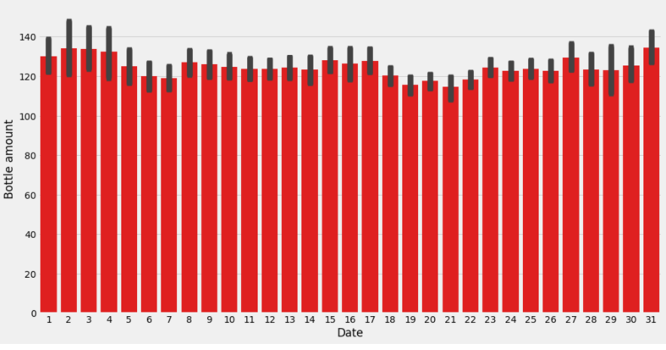
Insight: :-From above Bargraph we can see that On Date 2 and 31 Highest Amount of Milk Consumed from Bottle by Babies.It means on these Days babies did not Cry more

Slide 11
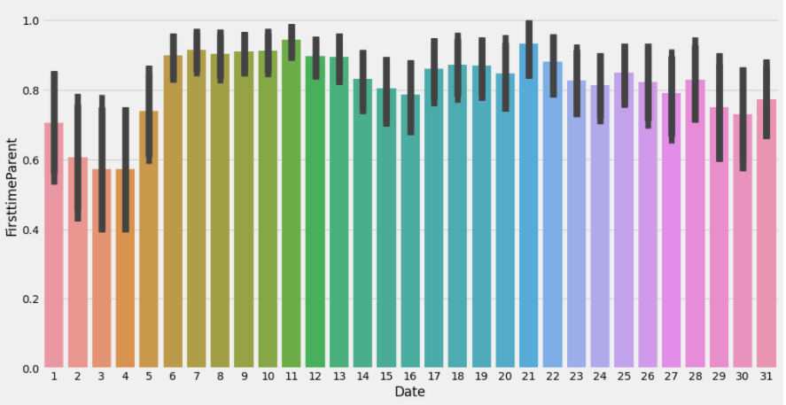
Insight :-From Above bar Graph we Can see that FirstTime Parent is highest on Date 21 Aug 2015.Which means Most of the Baby born on that Day.Doctors worked Hard on That Day

Slide 12
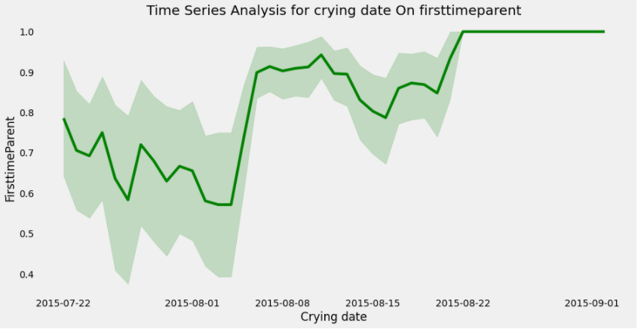
Insight :-From the Above Time Series Analysis of Line Plot we can see a Linear Relationship b/w Firsttime Parents and Crying Date.Which means Who becomes First Time Parents their Baby Cry More.Because Parents Are Not Experienced.

Slide 13
Now, BIRTH DATASET INSIGHTS

Slide 14
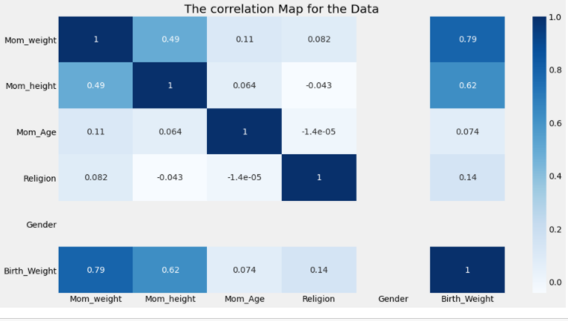
Insight:- In upper heatmap, we clearly see a strong positive corelation b/w Mom_weight & Birth_weight.which means if the Mom weight increases then birth_weight will also increases

Slide 15
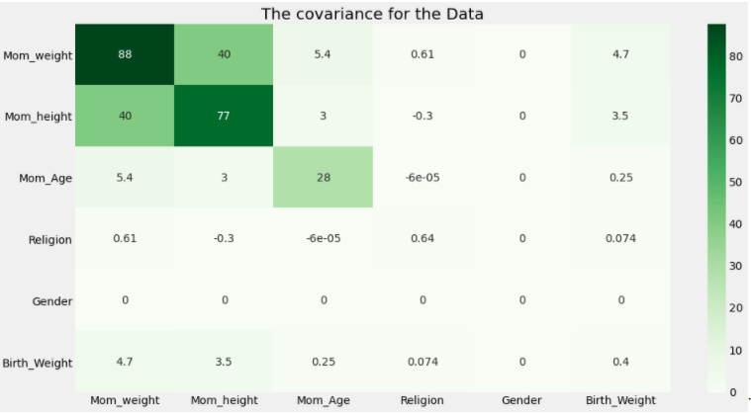
insight:- from this heat map we can analyed the data and make a decision that the covariance between Mom Weight and Birth_weight is vary high and Somehow Covariance of Mom Height is Also Good with Birth_weight. so that we can say that all three Columns data move together in the dataset.

Slide 16
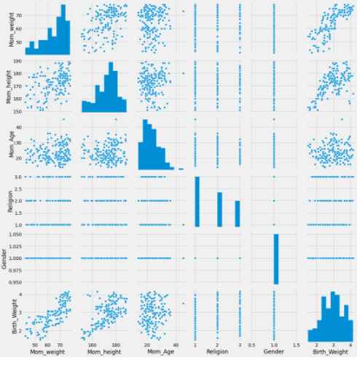
Insight:- In above Pairplot we can clearly see the positive Linear relationship b/w Mom_weight & Mom_height with Birth_weight. which means If Mom_weight and Mom_height increase Than Birth_weight will also Increase

Slide 17
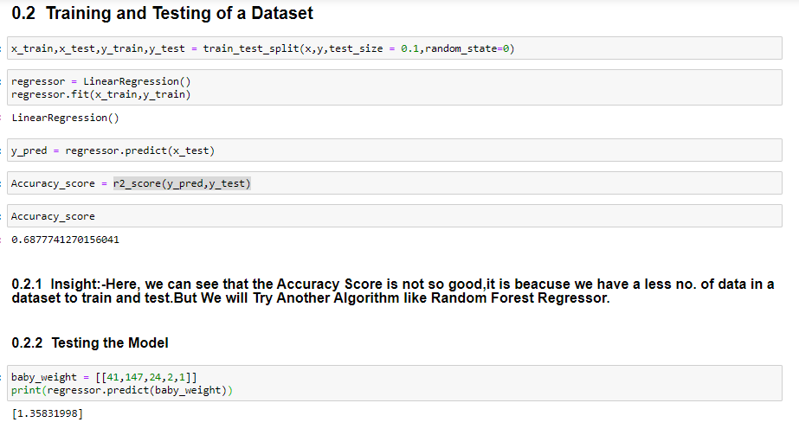
Insight:-Here, we can see that the Accuracy Score is not so good,it is beacuse we have a less no. of data in a dataset to train and test.But We will Try Another Algorithm like Random Forest Regressor
From the above evaluation of Linear Regression Model we can see by giving input values.The baby_weight is 1.35kg.

Slide 18
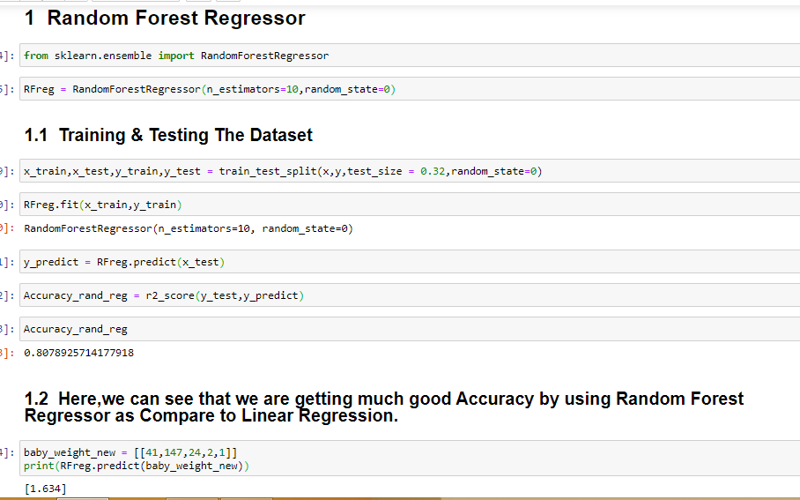
Here,we can see that we are getting much good Accuracy by using Random Forest Regressor as Compare to Linear Regression.
From the above evaluation of Random Forest Regressor we can see by giving input values.The baby_weight_new is 1.63kg

